Slide 1
Control of microbial growth
Surgical procedures and even more invasive medical procedures are performed frequently in hospitals.

Slide 2
A major risk of all such procedures is the introduction of pathogens into deeper tissues that can lead to life threatening infection.
Failure to properly disinfect or sterilize equipment carries not only risk associated with breach of host barriers but also risk for person-to-person transmission.

Slide 3
Disinfection and sterilization are essential for ensuring that medical and surgical instruments do not transmit infectious pathogens to patients.

Slide 4
Critical items
Critical items confer a high risk for infection if they are contaminated with any microorganism. Thus, objects that enter sterile tissue or the vascular system must be sterile because any microbial contamination could transmit disease.

Slide 5
Critical items
This category includes surgical instruments, cardiac and urinary catheters, implants, and ultrasound probes used in sterile body cavities. Most of the items in this category should be purchased as sterile or be sterilized with steam if possible.

Slide 6
Semicritical Items
Semicritical items contact mucous membranes or nonintact skin. This category includes respiratory therapy and anesthesia equipment, some endoscopes, laryngoscope blades, esophageal manometry probes, cystoscopes, anorectal manometry catheters, and diaphragm fitting rings.

Slide 7
These medical devices should be free from all microorganisms; however, small numbers of bacterial spores are permissible, because mucous membranes are often resistant to infections by spores.

Slide 8
Noncritical
Noncritical items are those that come in contact with intact skin but not mucous membranes. Intact skin acts as an effective barrier to most microorganisms; therefore, the sterility of items coming in contact with intact skin is "not critical."

Slide 9
noncritical
Noncritical items are divided into noncritical patient care items and noncritical environmental surfaces
Examples of noncritical patient-care items are bedpans, blood pressure cuffs, crutches and computers.

Slide 10
Noncritical
Noncritcal environmental surfaces include bed rails, some food utensils, bedside tables, patient furniture and floors. Noncritical environmental surfaces frequently touched by hand (e.g., bedside tables, bed rails) potentially could contribute to secondary transmission by contaminating hands of health-care workers or by contacting medical equipment that subsequently contacts patients

Slide 11
Factors affecting sterilization and disinfection
The activity of germicides against microorganisms depends on a number of factors, some of which are intrinsic qualities of the organism, others of which are the chemical and external physical environment. Awareness of these factors should lead to better use of disinfection and sterilization processes and will be briefly reviewed

Slide 12
Number and Location of microorganisms
Innate Resistance of Microorganisms
Concentration and Potency of Disinfectants
Physical and Chemical Factors –
  tempt,
  humidity,
  pH,
  Hardness of water.

Slide 13
Organic and Inorganic Matter
Duration of Exposure
Biofilms

Slide 14
CLEANING
Cleaning is the removal of foreign material (e.g., soil, and organic material) from objects and is normally accomplished using water with detergents or enzymatic products. Thorough cleaning is required before high-level disinfection and sterilization because inorganic and organic materials that remain on the surfaces of instruments interfere with the effectiveness of these processes.

Slide 15
Also, if soiled materials dry or bake onto the instruments, the removal process becomes more difficult and the disinfection or sterilization process less effective or ineffective. Surgical instruments should be presoaked or rinsed to prevent drying of blood and to soften or remove blood from the instruments.

Slide 16
Cleaning
Good cleaning is a form of disinfection.
Examples : hand washing f/b drying reduces the numbers of the organisms.
..drying of anesthetic tubing and apparatus in drying cabinet.

Slide 17
Disinfection and sterilization

Slide 18
Sterilization
Complete removal of all organisms including the bacterial vegetative forms, bacterial spores, viruses, fungi, fungal spores and protozoa, protozoan cysts.

Slide 19
Disinfection
Removal of some type of pathogenic microorganisms especially the vegetative forms. This does not include the spores.
It is partial reduction of the total number of organisms present, so that it can not initiate infection.

Slide 20
Heat disinfection
Used on inanimate objects(lifeless).
It removes the vegetative forms but the sores remain.
Eg pasteurization, boiling, low tempt steam disinfection.

Slide 21
Pasteurization
It is keeping the object at 63oC for 30min(holder type process). It is used for decontamination of babies’ feeding bottles.
It can be done at 72oC for 20min(flash process) or at 80oC for 1min.
anesthetic apparatus, face masks, bedpans.

Slide 22
Boiling
Heating items to 100oC kills pathogenic organisms in less then one min.
Spores of Clostridium tetani spores resist killing for a long time, but Clostridium perfringens spores are killed in 20min of boiling.

Slide 23
Low tempt steam disinfection
This uses a type of autoclave which generates steam to heat objects at 75oC.
In 20-30 min kills most pathogens.
Sometimes formaldehyde is added if spores are also targeted to be killed .. This is employed for the disinfection of some endoscopes.

Slide 24
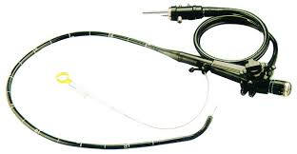
endoscope

Slide 25
Chemical disinfection
Application of chemicals to reduce the numbers of microbes.
Antiseptics are chemical disinfectants applied to living tissues eg skin. Note that some disinfectants are too harsh to be used on the skin.

Slide 26
Disinfectants are limited in scope of organisms they act against eg quartenary ammonium compounds (QAC) such as cetrimide, or benzalkonium chloride have good activity against E. coli but poor activity against Pseudomonas aeruginosa.

Slide 27
Factors determining the effectiveness of a chemical disinfection
1.Select correct chemical for the purpose it is required. Eg it is better to use hypochloride instead of phenols for cleaning Hepatitis contaminated blood from the floor.
2 use correct concentration of disinfectant.

Slide 28
3. leave the chemical on the surface for the reqiured time (time of exposure).eg 2% glutaraldehyde for 3-5min may kill Mycobacterium tub. and pseudomonas aeruginosa.
Endoscopes must be left in the disinfectant for 3h.

Slide 29
4. Correct pH of the disinfectant. Always read the manufaturer’s instruction. Eg one type of glutaraldehyde requires the addition of alkaline activator.
5. wash away inactivation material first.
Organic materials such as pus, vomit, faeces, body fluids inactivate disinfectants. phenols are less inactivated. Soap inactivates QAC

Slide 30
6. temperature and volume of disinfectant.
Hot water is better than cold water for dilution. Add plenty of disinfectant to the material.

Slide 31
7. some organisms can grow in dilute disinfectants, especially in antiseptics.
Topical disinfectants must be diluted fresh and use or use alcohol containing disinfectant.eg 1.5% iodine in spirit or alcoholic chlorhexidine.

Slide 32
Always clean disinfectant containers adequately and dry them.

Slide 33
Types of disinfectants
Alcohols
Eg isopropyl alcohol and ethyl alcohol.
Use
Skin antiseptic, before injection or venepuncture.

Slide 34
Diguanides
Eg chlorhexidine , 4% in detergent is called Hibiscrub…good for the hands of staff..surgeons.
Use
Pre operative skin preparation.

Slide 35
Halogens
Eg hypochlorites and chlorines
Good against HIV and HBsAg blood spilages.

Slide 36
Phenolics
Phenols –carbolic acid
Chloroxylenol
Hexachlorophane
Uses .. Are good antibacterial disinfectants.

Slide 37
Quartenary ammonium compounds
Eg cetrimide, Benzalkonium chloride
Uses. Mixed with chlorhexidine, it is a good disinfectant.

Slide 38
Sterilization
Complete removal of all types of microbes.
Achievable by one of ff:
1. Heat method… dry heat or moist heat.
2. Ionizing radiation
3. Ethylene oxide gas.

Slide 39
Dry sterilization process
Dry sterilization process (DSP) uses hydrogen peroxide at a concentration of 30-35% under low pressure conditions.
This process achieves bacterial reduction of 10⁻⁶...10⁻⁸. The complete process cycle time is just 6 seconds, and the surface temperature is increased only 10-15 °C.

Slide 40
Originally designed for the sterilization of plastic bottles in the beverage industry, because of the high germ reduction and the slight temperature increase the dry sterilization process is also useful for medical and pharmaceutical applications.
In medical processes it is a disinfection ---not sterilization as it is misnomed in food industry(inappropriate).

Slide 41
Peracetic acid
Peracetic acid (0.2%) is used to sterilize instruments.

Slide 42
Silver
Silver ions and silver compounds show a toxic effect on some bacteria, viruses, algae and fungi.
Its germicidal effects kill many microbial organisms in vitro.

Slide 43
Potential for chemical sterilization of prions
Prions are highly resistant to chemical sterilization.
Treatment with aldehydes (e.g., formaldehyde) have actually been shown to increase prion resistance.
Hydrogen peroxide (3%) for one hour was shown to be ineffective, providing less than 3 logs (10⁻³) reduction in contamination.

Slide 44
Iodine, formaldehyde, glutaraldehyde and peracetic acid also fail to act on prions.
Only chlorine, phenolic compounds, guanidinium thiocyanate, and sodium hydroxide (NaOH) reduce prion levels by more than 4 logs.
Chlorine and NaOH are the most consistent agents for prions.

Slide 45
Hydrogen peroxide
Hydrogen peroxide is another chemical sterilizing agent. It is relatively non-toxic when diluted to low concentrations, such as the familiar 3% retail solutions although hydrogen peroxide is a dangerous oxidizer at high concentrations (> 10% w/w).

Slide 46
Hydrogen peroxide is strong oxidant and these oxidizing properties allow it to destroy a wide range of pathogens and it is used to sterilize heat or temperature sensitive articles such as endoscopes.

Slide 47
Concentrations required
In medical sterilization hydrogen peroxide is used at higher concentrations, ranging from around 35% up to 90%.

Slide 48
Disadvantage
The biggest advantage of hydrogen peroxide as a sterilant is the short cycle time.
Whereas the cycle time for ethylene oxide (discussed above) may be 10 to 15 hours, the use of very high concentrations of hydrogen peroxide allows much shorter cycle times.
Some hydrogen peroxide modern sterilizers, such as the Sterrad NX have a cycle time as short as 28 minutes.

Slide 49
Filtration methods
Seitz filters .. Filter bacteria from fluids
Millipore filters.. Filter fluids
Glass wool, gauze, etc are used to filter air from ventilators.

Slide 50
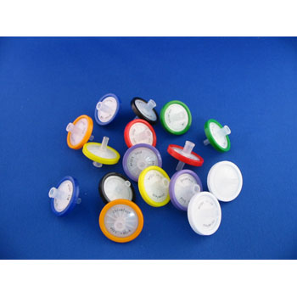

Syringe filters
Syringe Filter Specifications
Pore size: 0.22, 0.45µm.
Size (diameter): 13, 25, 33mm
Pack: 100qty/per box

Slide 51
Radiation sterilization
Methods of sterilization exist which uses radiation such as
1. electron beams,
2. X-rays,
3. gamma rays
4. subatomic particles

Slide 52
Gamma rays are very penetrating and are commonly used for sterilization of disposable medical equipment, such as syringes, needles, cannulas and IV sets.
Electron beam processing is also commonly used for medical device sterilization.

Slide 53
X-rays, High-energy X-rays called bremsstrahlung are a form of ionizing energy allowing to irradiate large packages and pallet loads of medical devices.

Slide 54
UV light
Ultraviolet light irradiation (UV, from a germicidal lamp) is useful only for sterilization of surfaces and some transparent objects.
Many objects that are transparent to visible light absorb UV. Glass for example completely absorbs all UV light.
UV irradiation is routinely used to sterilize the interiors of biological safety cabinets between uses, but is ineffective in shaded and dirty areas.

Slide 55
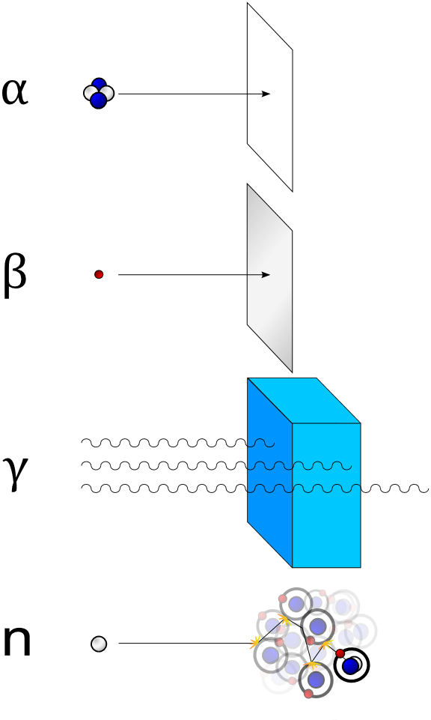

Slide 56
Ethylene Oxide gas
Ethylene oxide is one of the most important raw materials used in the large-scale chemical production.
Most ethylene oxide is used for synthesis of ethylene glycols, including diethylene glycol and triethylene glycol.

Slide 57
Many forms
Polyethyleneglycols are used in perfumes, cosmetics, pharmaceuticals, lubricants, paint thinners and plasticizers.
Ethylene glycol ethers are part of brake fluids, detergents, solvents, lacquers and paints.
Other products of ethylene oxide… Ethanolamines are used in the manufacture of soap and detergents and for purification of natural gas

Slide 58
Ethylene oxide
Ethylene oxide (EO or EtO) gas is commonly used to sterilize objects sensitive to temperatures greater than 60 °C and / or radiation such as plastics, optics and electrics. Ethylene oxide treatment is generally carried out between 30 °C and 60 °C with relative humidity above 30% and a gas concentration between 200 and 800 mg/l, and typically lasts for at least three hours.

Slide 59
EO or EtO
Ethylene oxide penetrates well, moving through paper, cloth, and some plastic films and is highly effective.
EtO can kill all known viruses, bacteria and fungi, including bacterial spores and is compatible with most materials of medical devices, even when repeatedly applied.

Slide 60
Disadvantages
It is highly flammable, toxic and carcinogenic

Slide 61
Dry heat
Flaming of bacteriological loops
Incinration of infected dressings are examples.
Hot air ovens are used. 160ºC for 1h oxidizes the protoplasm of the organism.
Good for glassware, powders like talc, oils. and petroleum jelly.

Slide 62
Moist heat
Steam kills bacteria by coagulating the cytoplasm. It is done in the autoclave.
The autoclave is similar to pressure cooker.
High pressure build up in the autoclave increasing the tempt above 100ºC.
Usually set at 121ºC for 15min.

Slide 63
Autoclave tapes are used to determine items that have been autoclaved.
To ensure sterility is achieved, spores of Bacillus stearothermophilus is added. It is removed, incubated for growth color change indicates growth or it is plated on blood agar and observed for growth.

Slide 64
Cleaning methods that do not achieve sterilization-- summary
This is a brief list of cleaning methods that may be thought to "kill germs" but do not achieve sterilization.
Washing in a dishwasher: Dishwashers often only use hot tap water or heat the water to between 49 and 60 °C, which is not hot enough to kill some bacteria on cooking or eating utensils.

Slide 65
Summary
Bathing can not sterilize skin, even using antibacterial soap.
Disinfectants (for non-living objects).
Antiseptics (for living objects such as skin) These can kill or remove bacteria and viruses, but not all.
Pasteurization of food also kills some bacteria and viruses, but not all.

